Slide 1

AI-Powered Disaster Response & Resilience (RescueNet)
A conceptual nonprofit platform demonstrating how ethical AI can save lives during disasters.
Under The Guidance of Dr. Anderson Prewitt
Presented By GROUP B
Ankita Tripathy
Divya Sharmila Penumaka
Neethika Kommidi
Swetha Singireddy
Vinay Sunkari

Slide 2
Challenges in Modern Disaster Response Systems
Fragmented Systems & Slow Coordination
Disaster-response data is scattered across multiple agencies (FEMA, Red Cross, NGOs) with limited interoperability.
Manual reporting and siloed databases delay information flow during the critical first 24 hours.
Unstructured data (satellite feeds, drone imagery, social media signals) remain underutilized for real-time decision-making.
Operational Pain Points
Delayed information sharing slows aid deployment.
Lack of centralized intelligence causes confusion in field operations.
Inconsistent data standards limit collaboration between national and local agencies.

Slide 3
Impact and Strategic Objective
Impact on Relief Operations
Inefficient resource allocation results in duplicated or missed aid efforts.
Misinformation spreads faster than verified alerts, undermining public confidence.
Delayed situational awareness leads to increased loss of life and property damage.
Strategic Objective: AI-Driven RescueNet
Build an AI-powered disaster-intelligence platform that unifies multi-source data in real time.
Deliver predictive insights and automated alerts to enhance coordination and speed.
Apply HEVIDS ethical principles to ensure transparency, integrity, and fairness in AI-driven decisions.

Slide 4
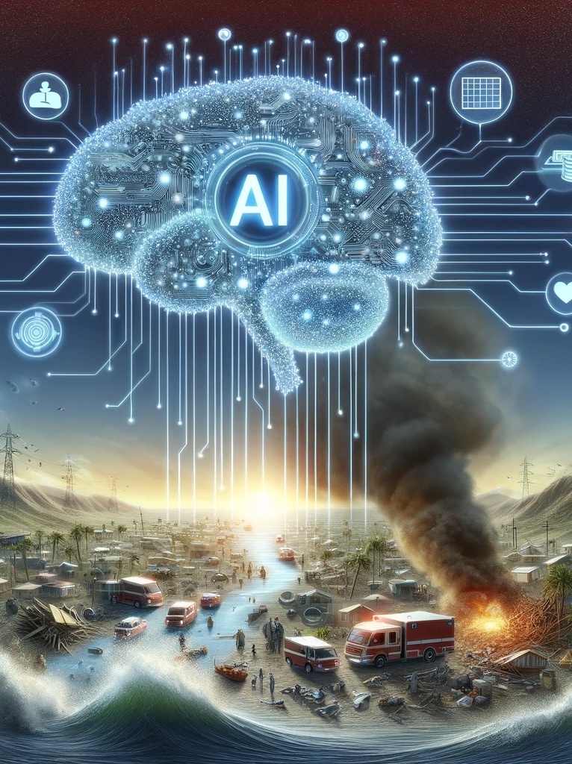
Organization Overview
About RescueNet
RescueNet is a nonprofit AI platform designed to support emergency planning, real-time response, and post-disaster recovery.
Operates in collaboration with FEMA, the Red Cross, state governments, and NGOs.
Uses AI, IoT, and predictive analytics to integrate satellite, drone, weather, and social data into a unified disaster intelligence system.

Slide 5
RescueNet Value Chain
Stage | Key Activities | Value Delivered
Data Collection | Aggregates data from satellites, drones, sensors, and social media | Creates unified, real-time disaster intelligence
AI Analysis & Prediction | Uses ML models for damage assessment, hotspot prediction, and misinformation filtering | Enables proactive planning and risk mitigation
Decision Support Dashboards | Visualizes situational data for agencies and responders | Improves communication and coordination
Response & Recovery | Guides logistics, resource deployment, and post-disaster analysis | Enhances speed, accountability, and resilience

Slide 6
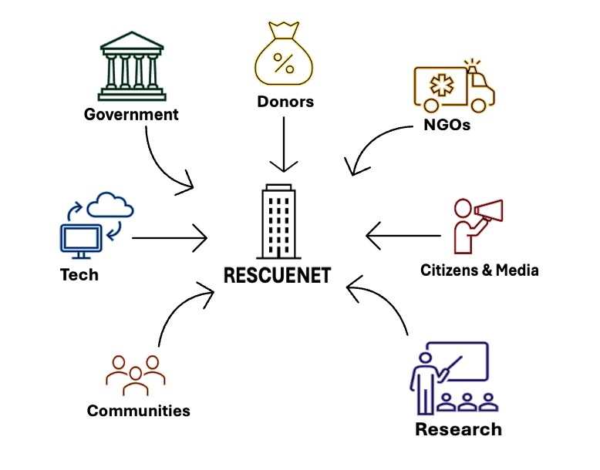
Stakeholder Ecosystem
Stakeholder | Role & Contribution | Key Benefits
Government & Agencies (FEMA, NDMA) | Governance, funding, public data sharing. | Faster decisions, lower recovery costs, improved preparedness.
NGOs & Humanitarian Orgs (Red Cross, UN OCHA) | Field operations, real-time data, logistics coordination. | Predictive analytics, transparent triage, efficient aid delivery.
Tech Partners (AWS, Microsoft, Oracle) | Provide cloud, AI tools, and cybersecurity infrastructure. | CSR visibility, ethical innovation, global partnerships.
Academia & Research | AI model validation, data analysis, ethical audits. | Access to datasets, applied research, collaboration.
Communities & Responders | On-ground updates, situational feedback, early alerts. | Real-time warnings, fair resource access, improved resilience.
Donors & Development Agencies (UNDP, World Bank) | Financial and strategic support, risk frameworks. | Transparent impact reports, measurable social ROI.
Citizens & Media | Share social signals, crowd-sourced alerts, monitor accountability. | Verified info, public safety, civic trust.

Slide 7
Current Enterprise Architecture & System Assessment
Existing System Components
Data Sources: Satellite imagery, IoT sensors, weather APIs, drone footage, and social-media inputs.
Data Storage: Separate servers/clouds for each agency, no shared repository or standardized format.
Communication Tools: Basic dashboards, radio dispatch, and manual reports exchanged via email.
Decision Support: Minimal use of analytics; responses rely on static maps and manual judgment.
Assessment Summary
⚠️ Fragmented architecture → poor interoperability between agencies.
⚠️ Lack of automation → delayed analysis and slow response cycles.
⚠️ Weak data governance → inconsistent accuracy and limited traceability.
⚠️ No predictive layer → decisions remain reactive rather than proactive.

Slide 8
Strengths
Weaknesses
Strong partnerships with FEMA, Red Cross, NGOs. AI + multi-source data integration (satellite, drone, HEVIDS ethical governance ensures fairness & trust. Mission-driven nonprofit collaboration model. | Limited funding and reliance on grants. Early-stage platform with limited training data. Dependence on external data quality. Need for AI talent & stronger cybersecurity. Limited data bias detection and explainability mechanisms.
Government funding for AI-based disaster solutions. Partnerships with cloud providers (AWS, Google, Microsoft). Global push for ethical & explainable AI. Expansion into international humanitarian networks. | Cybersecurity & data privacy concerns. Regulatory hurdles (GDPR, HIPAA, FISMA). Resistance to change from legacy agencies. Unpredictable disasters impacting data reliability. Potential bias or misinfor mation from unverified data sources.
Opportunities
Threats

Slide 9
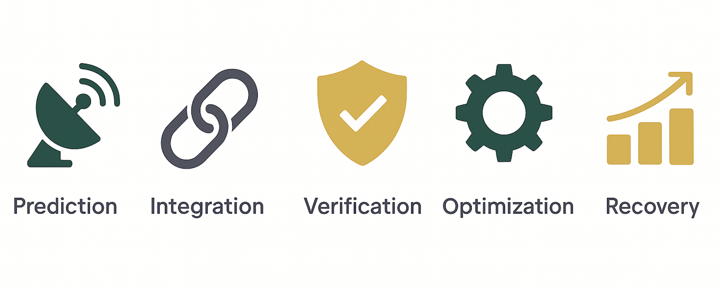
AI Implementation Opportunities
Predictive Risk Analytics​
ML models forecast disaster intensity, impact zones, and population risk.​
Enables pre-positioning of resources and early evacuation planning.​
Real-Time Data Fusion & Decision Support​
Integrates satellite, drone, sensor, weather, and social-media data into one live dashboard.​
Provides shared situational awareness for FEMA, Red Cross, and NGOs.​
Misinformation Detection & Social Signal Analysis​
NLP models flag false or duplicate posts and extract urgent distress signals.​
Improves accuracy and public trust in crisis communications.​
Resource Optimization & Logistics Planning​
AI recommends optimal supply routes and deployment plans based on terrain and hazards.​
Cuts delivery time, reduces cost, and minimizes duplication.​
Post-Disaster Recovery Analytics​
Image recognition estimates damage levels and recovery timelines.​
Supports transparent reporting for donors and policymakers.

Slide 10
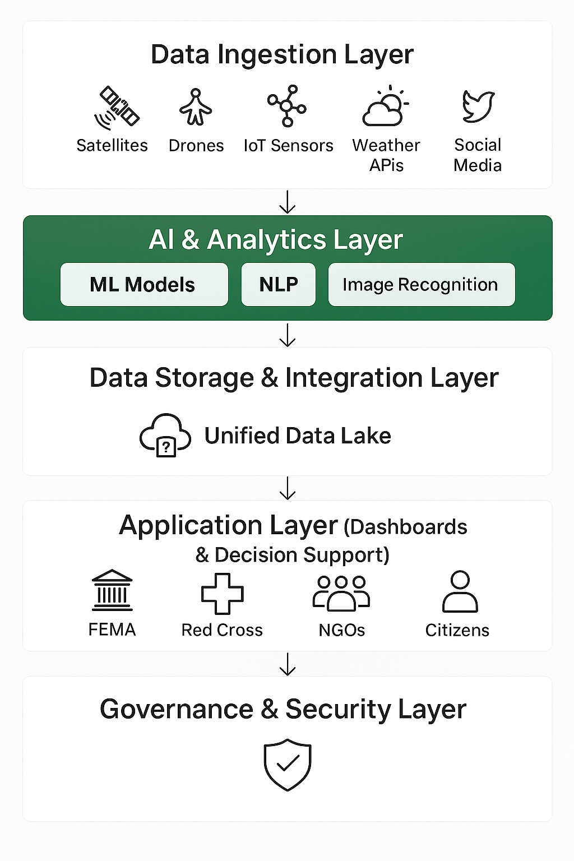
Proposed AI-Integrated System Architecture
Data Ingestion Layer
Collects multi-source data (satellites, drones, IoT, weather, social feeds).
Cleans, validates, and standardizes inputs through ETL pipelines and Kafka streaming for consistent quality.
AI & Analytics Layer
Applies ML and NLP models for risk prediction, resource optimization, and misinformation detection.
Maintains data lineage and provenance for transparency and explainability.
Data Storage & Integration Layer
Hosts a secure, unified cloud data lake integrating FEMA, Red Cross, and NGO systems.
Supports API-based data exchange, IAM-controlled access, and audit trails to track all transactions.
Application Layer
Interactive dashboards show real-time alerts, maps, and operational insights.
Role-based access ensures agencies and responders see relevant data securely.
Governance & Security Layer
Enforces HEVIDS ethical AI, AES-256 encryption, and continuous security audits.
Includes data quality monitoring, incident logging, and automated backup for resilience

Slide 11
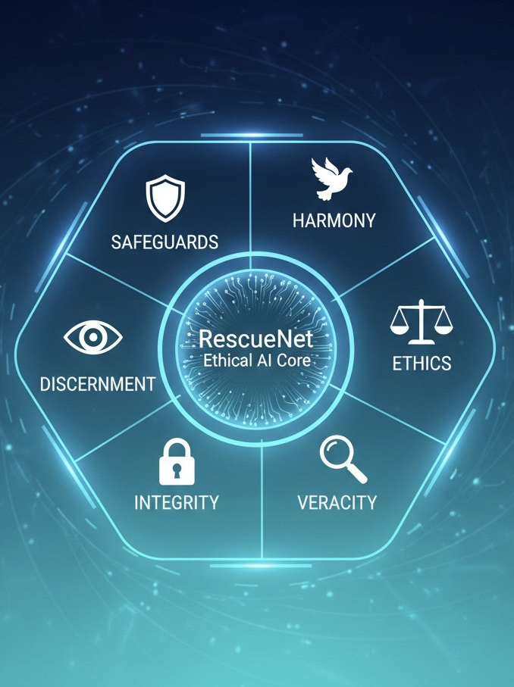
The HEVIDS Framework
Principle | Description
Harmony | Aligns AI goals with FEMA and Red Cross missions to save lives; AI recommendations support not replace human decision-makers
Ethics | Trains models only on verified, consented, and non-discriminatory data sources; excludes biased or misleading inputs.
Veracity | Validates all incoming data (satellite, sensor, social feeds) for accuracy using data-quality checks and cross-verification.
Integrity | Ensures secure data pipelines with end-to-end encryption and blockchain-based audit logs for traceability.
Discernment | Maintains a “human-in-the-loop” protocol, analysts and responders review AI predictions before action is taken.
Safeguards | Applies strong cybersecurity to ensure continuity even during network failure.

Slide 12
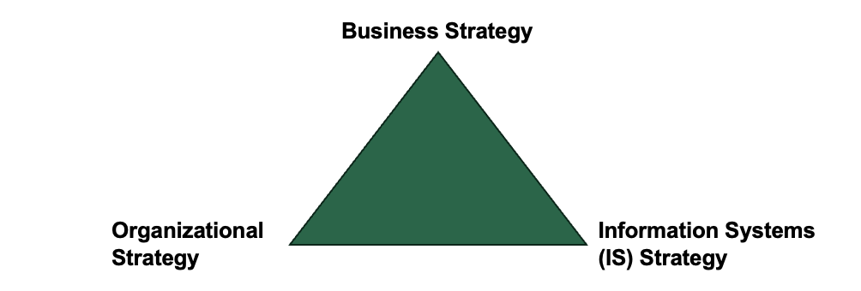
IS Strategy Triangle Alignment
Business Strategy – Mission-Driven Impact
It predicts, prepares, and protects lives during disasters by enabling data-based decisions for FEMA, Red Cross, and NGOs while ensuring transparency through HEVIDS ethical principles.
Organizational Strategy – Networked Collaboration
Unites agencies and partners through shared data and real-time dashboards, establishing clear roles and coordination while promoting training and change management for smooth AI adoption
Information Systems (IS) Strategy – AI-Powered Backbone
Built on AWS/Azure with API-based microservices, leveraging ML and NLP for forecasting, resource allocation, and misinformation control while ensuring encryption, security, and ethical compliance through HEVIDS governance.

Slide 13
Strategic Framework Alignment
RescueNet aligns with global enterprise frameworks to ensure responsible, efficient, and scalable AI implementation in disaster management.
Framework | How RescueNet Aligns
Digital Transformation | Transforms traditional, manual disaster management into a data-driven ecosystem using AI for prediction, drone and IoT integration for real-time visibility, and automated alerts for faster response.
COBIT 5 / 2019 | Establishes governance objectives and control mechanisms through the HEVIDS Ethics Board, quarterly audits, and defined accountability for data, risk, and AI model integrity.
ISO 27001 | Implements information-security standards including encryption, secure cloud storage, identity management, and continuous monitoring to protect sensitive disaster and citizen data.
Business–IT Alignment | Aligns RescueNet’s humanitarian mission with its AI and cloud infrastructure, ensuring that technology directly supports field operations, decision dashboards, and cross-agency coordination.

Slide 14
Governance Structure & Risk Management
Executive Steering Committee: Defines mission, funding, and policy direction.
AI Ethics Board (HEVIDS): Reviews bias, fairness, and explainability in models.
Data Governance Team: Ensures data accuracy, provenance, and secure sharing.
Technical Operations: Manages uptime, cybersecurity, and cloud infrastructure.
Compliance & Audit: Conducts ISO 27001 / COBIT reviews, enforces GDPR, FISMA, HIPAA.
Risk Areas & Mitigation Approaches
Risk Area | Mitigation Approach
AI Bias & Fairness | Ongoing bias testing, retraining, and Ethics Board review
Data Privacy & Security | Encryption, anonymization, IAM, and audit trails
Model Explainability | Transparent dashboards + human validation loop
System Reliability | Multi-cloud redundancy, 24/7 monitoring
Integration Risk | Phased rollout and sandbox testing
Regulatory Compliance | Quarterly audits & HEVIDS-aligned governance policies

Slide 15
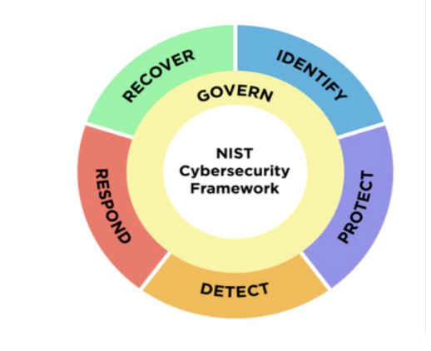
Cybersecurity Risks & Mitigation
Cybersecurity ensures RescueNet’s reliability through NIST CSF and HEVIDS, keeping data secure, resilient, and ethical during high-pressure disaster operations.
NIST CSF Implementation
Identify: Asset inventory + risk classification
Protect: Zero-Trust, MFA, AES-256
Detect: AI threat detection + continuous monitoring
Respond: Incident playbooks + coordination
Recover: Redundant cloud + automated backups
Risk | Mitigation | Impact
Data Breach | Zero-Trust + MFA + Encryption | Protects sensitive data and maintains trust
Ransomware | AI threat detection + monitoring | Prevents system lockouts during crises
DDoS Attacks | Rate-limiting + geo-redundant cloud | Keeps platform available in emergencies
Data Tampering | Blockchain logs + data validation | Ensures decisions use accurate data
Supply Chain Weakness | Vendor checks + sandbox testing | Stops failures from third-party tools
Insider Threats | Least-privilege access + audit logs | Reduces misuse and improves accountability
Compliance Violations | GDPR/HIPAA policies + audits | Avoids legal risk and protects privacy
AI Bias | Bias audits + human oversight (HEVIDS) | Ensures fair and transparent AI decisions

Slide 16
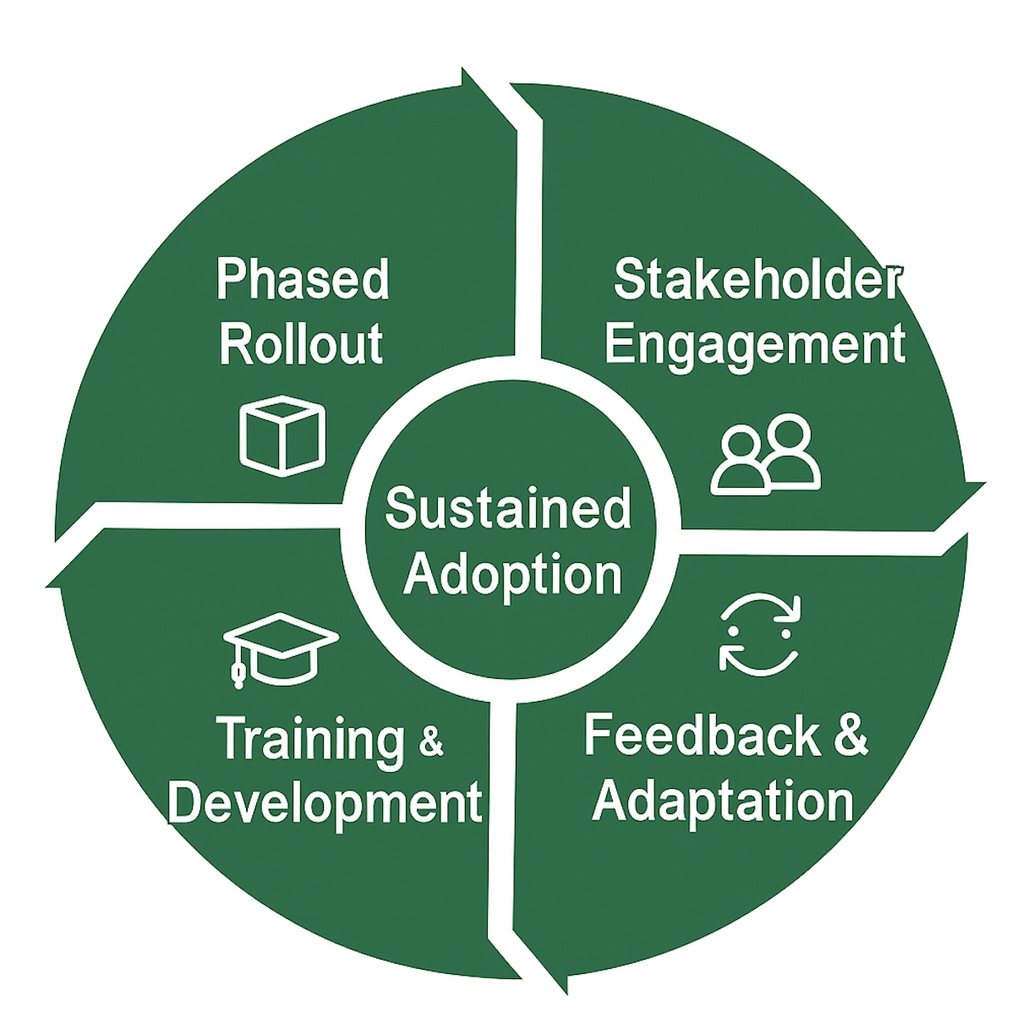
Change Management & Implementation Strategy
1. Phased Rollout
Pilot → Scale → Institutionalize
Gradual adoption with feedback checkpoints
2. Stakeholder Engagement
Regular briefings, workshops & transparent reporting
Two-way communication channels for feedback
3. Training & Development
Role-based modules for executives, analysts, and responders
Ongoing simulation drills & refresher sessions
4. Feedback & Adaptation
Built-in feedback loops & KPI tracking
Model updates based on user insights
5. Theoretical Foundation
Guided by Kotter’s 8-Step Model & Lewin’s Change Theory
Focus on culture, motivation, and sustained adoption

Slide 17
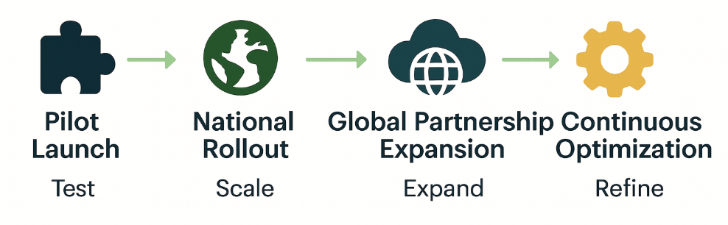
Integration & Deployment Strategy
Phase | Technical Focus | Key Outcome
1 – Pilot Launch | Deploy containerized AI modules in one FEMA region; test data pipelines & API latency. | Validate model accuracy & integration stability.
2 – National Rollout | Connect state agencies via secure VPN and API gateway, establish 24/7 monitoring dashboards. | Enable nationwide real-time situational awareness.
3 – Global Partnership Expansion | Add multilingual AI models & international cloud nodes (UN, WHO). | Achieve global interoperability for cross-border response.
4 – Continuous Optimization | Retrain models with new disaster datasets; apply MLOps for automated updates. | Enhance predictive accuracy & reduce response latency.

Slide 18

Training & Development Strategy
Focus Area | Summary
Capacity Building | Scenario-based AI and data training helps responders make fast, ethical, data-driven decisions.
Hybrid Skill Roles | Roles like AI Coordinator and Data-Ethics Officer bridge technology with humanitarian response.
AI Ethics & Governance | Workshops embed HEVIDS & NIST principles to ensure transparency, fairness, and accountability.
Continuous Learning | Post-deployment feedback retrains AI, updates user skills, and improves coordination.
Strategic Outcome | Fosters a culture of ethical intelligence aligning human expertise and AI for saving lives.

Slide 19
Technologies
RescueNet uses a modern, secure, and scalable technology stack that supports data integration, machine learning, and ethical AI governance.
Designed to comply with government and nonprofit technology standards.
Layer | Technologies / Tools | Purpose
Cloud Infrastructure | AWS, Azure Government Cloud | Hosting, scalability, and security
Databases | PostgreSQL, MongoDB | Store structured/unstructured data
AI Frameworks | TensorFlow, PyTorch, Scikit-learn | Predictive analytics, NLP, image recognition
Integration Tools | Apache Kafka, REST APIs, Docker Containers | Data streaming, system integration
Visualization | Power BI, Tableau, Custom Dashboards | Real-time insights and decision support
Security & Ethics | Encryption, IAM, HEVIDS Governance | Data Protection, compliance, transparency

Slide 20
Implementation Timeline & Budget
Phase | Duration | Key Activities | Deliverables | Budget (USD) | % of Total
Foundation Setup | 0–6 mo | Governance setup, data policy | Governance Charter | $500,000 | 15%
Pilot Development | 7–15 mo | AI pilot in two regions | Pilot Report | $700,000 | 20%
Scale-Up & Integration | 16–24 mo | Multi-agency expansion | Integration Plan | $900,000 | 26%
Optimization & Resilience | 25–36 mo | Security audits, training | Resilience Framework | $800,000 | 23%
Global Expansion | 37+ mo | UN SDG partnerships, dashboard | Global Impact Report | $600,000 | 16%

Slide 21
Business Value, Impact & Key Performance Indicators (KPIs)
Dimension | Metric | Target | Outcome
Operational Efficiency | Response Time | ↓ 30–40% | Faster coordination
Equity & Impact | Aid Accuracy | ↑ 25% | Fair distribution
Trust & Transparency | False Info Suppression | ≥ 70% / 30 min | Reliable data
Resilience & Availability | System Uptime | ≥ 99.9% | Reliable in crises
Learning & Improvement | Training Completion | 100% | Continuous readiness
Return on Investment (ROI)
30–40% faster inter-agency coordination through AI forecasting and automation.
15–20% cost reduction by eliminating duplication and manual reporting.
Real-time dashboards enable transparent, audit-ready fund management.
Savings reinvested in training, infrastructure, and community capacity building.
Return on Societal Value (RSV)
HEVIDS-based AI ensures fair and unbiased aid distribution.
Real-time vulnerability mapping prioritizes children, elderly, and low-income families.
Transparency dashboards build public trust and donor confidence.
Predictive alerts empower communities to act faster and reduce losses.

Slide 22

Evaluation & Continuous Improvement
Evaluation Framework
Quarterly Reviews – Track KPIs: response time, uptime, fairness.
HEVIDS Audits – Assess ethics, bias, and data transparency.
User Feedback – Field insights from NGOs and responders.
External Audits – Annual cybersecurity & financial reviews.
Continuous Improvement
AI Model Training – Retrain with new disaster datasets.
Policy Updates – Refresh HEVIDS + NIST governance.
Global Collaboration – Apply lessons from FEMA, UNDP, Red Cross.
Transparency – Publish SDG-aligned impact dashboards.

Slide 23
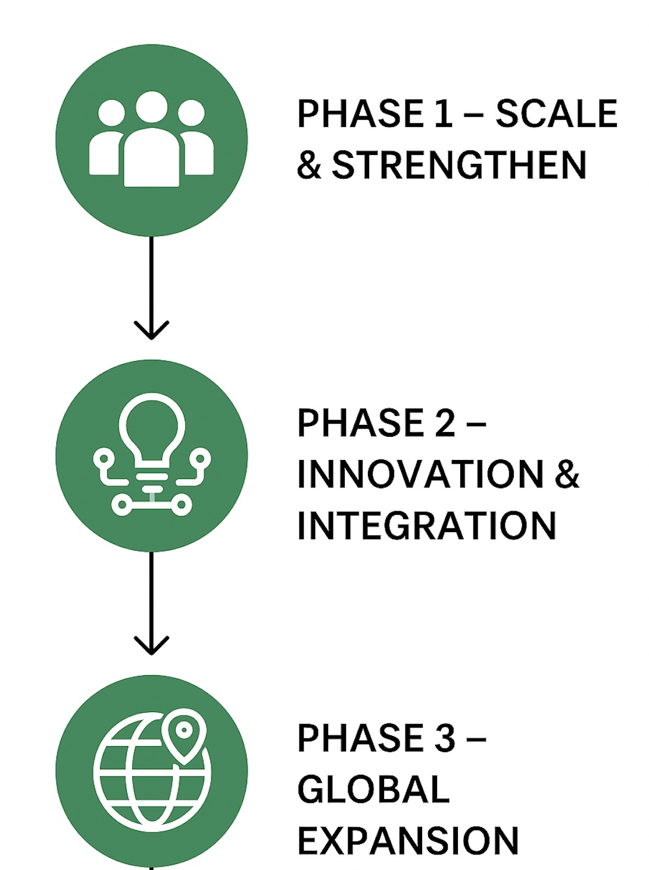
Future Work
Phase 1 – Scale & Strengthen (2026)
Expand RescueNet deployment across all U.S. regions.
Improve AI accuracy with larger disaster datasets and active learning.
Implement federated learning to enhance privacy across agencies.
Phase 2 – Innovation & Integration (2027)
Integrate edge AI for faster real-time analysis in field operations.
Adopt advanced HEVIDS-aligned ethics frameworks for global standards.
Strengthen interoperability through open-data APIs and cloud scalability.
Phase 3 – Global Expansion (2028)
Partner with UN, WHO, and international NGOs for global response use.
Adapt to emerging AI regulations and create regional compliance modules.
Extend use cases to climate forecasting and supply-chain resilience.

Slide 24

References
NIST Cybersecurity Framework National Institute of Standards and Technology. (2018). Framework for improving critical infrastructure cybersecurity (Version 1.1). https://www.nist.gov/cyberframework
NIST Security & Privacy Controls (SP 800-53) National Institute of Standards and Technology. (2020). Security and privacy controls for information systems and organizations. https://csrc.nist.gov/publications/detail/sp/800-53/rev-5/final
Prewitt, A. (2024). HEVIDS Framework Lecture Notes. University of South Florida.
Floridi, L., & Cowls, J. “A Unified Framework of Five Principles for AI in Society.” Harvard Data Science Review, 1(1), 2019.
United Nations Office for Disaster Risk Reduction. (2015). Sendai framework for disaster risk reduction 2015–2030. United Nations.
Disaster Resilience Indicators Cutter, S. L., et al. (2014). A framework for disaster resilience indicators. International Journal of Disaster Risk Reduction, 5, 6–15. https://doi.org/10.1016/j.ijdrr.2013.08.004
Ethical AI Governance Mitchell, M., & Bryson, J. (2021). The case for ethical AI governance. AI & Society. https://doi.org/10.1007/s00146-021-01256-3

